Slide 1
Conflict resolution
Team of Concern

Slide 2
You can never achieve personal growth through conflict.
True
False

Slide 3
Which is not a healthy way to vent frustration and/or anger?
When you're upset, pause, and slowly count to ten
Take a cooling-off period
Punch a wall and not a person
Don't address anger when you're rushed
Don't try to address your anger when you're tired or before sleep
Notes:
Answer - 3

Slide 4
Conflict can sometimes arise when basic needs are not met. Which one is not a basic need?
Love
Fun
Freedom
Survival
Happiness
Notes:
Answer - 5

Slide 5
What is conflict?
Notes:
Ask students to define/describe conflict. Ask if their definitions/descriptions have a positive or negative connotation

Slide 6
What is Conflict???
A conflict is more than just a disagreement.
Conflicts continue to fester when ignored.
We respond to conflicts based on our perceptions.
Conflicts trigger strong emotions.
Conflicts are opportunities for growth.
Notes:
A conflict is more than just a disagreement. It is a situation in which one or both parties perceive a threat (whether or not the threat is real).
Conflicts continue to fester when ignored. Because conflicts involve perceived threats to our well-being and survival, they stay with us until we face and resolve them.
We respond to conflicts based on our perceptions of the situation, not necessarily to an objective review of the facts. Our perceptions are influenced by our life experiences, culture, values, and beliefs.
Conflicts trigger strong emotions. If you aren’t comfortable with your emotions or able to manage them in times of stress, you won’t be able to resolve conflict successfully.
Conflicts are opportunities for growth. When you’re able to resolve conflict in a relationship, it builds trust. You can feel secure knowing your relationship can survive challenges and disagreements.

Slide 7
What are some examples of conflict that students experience at home or school?

Slide 8
Is it ok to disagree with others?
Notes:
What feelings to do experience when you disagree with others?

Slide 9
5 Types
of
Conflict

Slide 10
5 Types of Conflict
Relationships
Occurs because of the presence of strong negative emotions, misperceptions or stereotypes, poor communication or miscommunication, or repetitive negative behaviors.
Relationship problems often fuel disputes and lead to an unnecessary escalating spiral of destructive conflict.
Supporting the safe and balanced expression of perspectives and emotions for acknowledgment (not agreement) is one effective approach to managing relational conflict.

Slide 11
5 Types of Conflict
Interests
Caused by competition over perceived incompatible needs.
Conflicts of interest result when one or more of the parties believe that in order to satisfy his or her needs, the needs and interests of an opponent must be sacrificed
Interest-based conflict is best resolved through the maximizing integration of the parties' respective interests, positive intentions and desired experiential outcomes.

Slide 12
5 Types of Conflict
Data
Occur when people lack information necessary to make wise decisions, are misinformed, disagree on which data is relevant, interpret information differently, or have competing assessment procedures.
Some data conflicts may be unnecessary since they are caused by poor communication between the people in conflict.
Other data conflicts may be genuine incompatibilities associated with data collection, interpretation or communication.
Most data conflicts will have "data solutions."

Slide 13
5 Types of Conflict
Structural
Caused by forces external to the people in dispute.
Limited physical resources or authority, geographic constraints (distance or proximity), time (too little or too much), organizational changes, and so forth can make structural conflict seem like a crisis.
It can be helpful to assist parties in conflict to appreciate the external forces and constraints bearing upon them.
Structural conflicts will often have structural solutions. Parties' appreciation that a conflict has an external source can have the effect of them coming to jointly address the imposed difficulties.

Slide 14
5 Types of Conflict
Values
Caused by perceived or actual incompatible belief systems.
Values are beliefs that people use to give meaning to their lives. Values explain what is "good" or "bad," "right" or "wrong," "just" or "unjust."
Differing values need not cause conflict. People can live together in harmony with different value systems.
Value disputes arise only when people attempt to force one set of values on others or lay claim to exclusive value systems that do not allow for divergent beliefs.
It is of no use to try to change value and belief systems during relatively short and strategic mediation interventions. It can, however, be helpful to support each participant's expression of their values and beliefs for acknowledgment by the other party.

Slide 15
Do your needs influence your feelings?

Slide 16
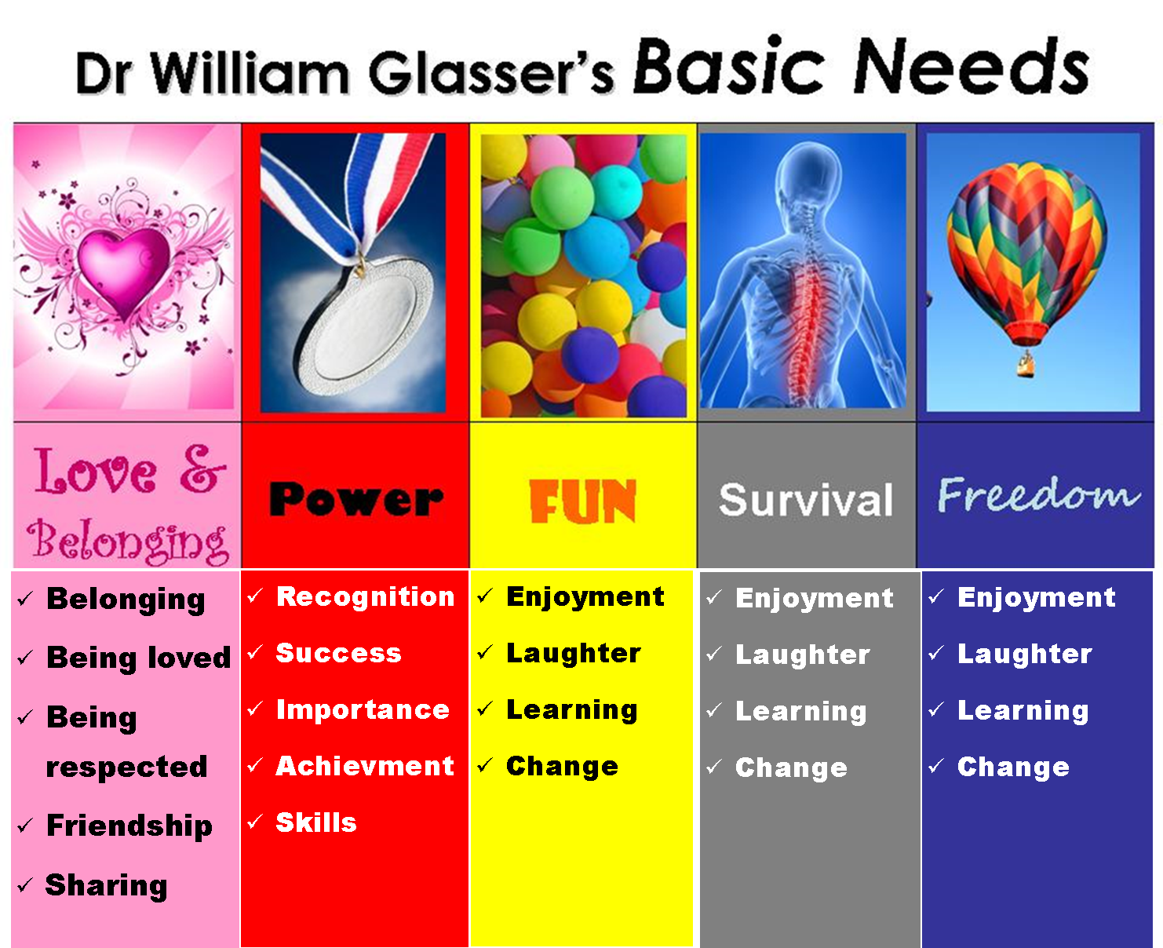

Slide 17
Can the way you react to those feelings have an effect on escalating or deescalating conflicts?

Slide 18
What is conflict resolution?
….a peaceful solution
Notes:
Conflict resolution is a way for two or more parties to find a peaceful solution to a disagreement among them.

Slide 19
When a dispute arises, often the best course of action is negotiation to resolve the disagreement.
The goals of negotiation are:
To produce a solution that all parties can agree to
To work as quickly as possible to find this solution
To improve, not hurt, the relationship between the groups in conflict
Conflict resolution through negotiation can be good for all parties involved.
Each side will get more by participating in negotiations than they would by walking away.
A way for your group to get resources that might otherwise be out of reach.

Slide 20
There are ways to work things out that allows everyone to meet their needs:
What are healthy ways to vent anger or frustration?
When you're upset, pause, and slowly count to ten
Take a cooling-off period
Don't address anger when you're rushed
Don't try to address your anger when you're tired or before sleep
Notes:
Here are some strategies to productively cope with anger in daily life.
4 Tips To Diffuse Anger
1. When you're upset, pause, and slowly count to ten. To offset the adrenaline surge of anger, train yourself not to lash back impulsively. Wait before you speak. Take a few deep breaths and VERY slowly, silently, count to ten (or to fifty if necessary). Use the lull of these moments to regroup before you decide what to do so you don't say something you regret
2. Take a cooling-off period. To further quiet your neurotransmitters, take an extended time-out, hours or even longer. When you're steaming retreat to a calm setting to lower your stress level. Reduce external stimulation. Dim the lights. Listen to soothing music. Meditate. Do some aerobic exercise or yoga to expel anger from your system.
3. Don't address anger when you're rushed. Make sure you have adequate time to identify what's made you angry. A Princeton study found that even after theology students heard a lecture on the Good Samaritan, they still didn't stop to help a distressed person on the street when they thought they'd be late for their next class. Thus, allotting unhurried time to resolve the conflict lets you tap into your most compassionate response.
4. Don't try to address your anger when you're tired or before sleep. Since anger revs up your system, it can interfere with restful sleep and cause insomnia. The mind grinds. Better to examine your anger earlier in the day so your adrenaline can simmer down. Also being well rested makes you less prone to reacting with irritation, allows you to stay balanced.
The goal with anger is to own the moment so this emotion doesn't own you. Then you can mindfully respond rather than simply react. You'll have the lucidity to be solution oriented and therefore empower how you relate to others.

Slide 21
You can never achieve personal growth through conflict.
True
False

Slide 23
Which is not a healthy way to vent frustration and/or anger?
When you're upset, pause, and slowly count to ten
Take a cooling-off period
Punch a wall and not a person
Don't address anger when you're rushed
Don't try to address your anger when you're tired or before sleep
Notes:
Answer - 3

Slide 25
Conflict can sometimes arise when basic needs are not met. Which one is not a basic need?
Love
Fun
Freedom
Survival
Happiness
Notes:
Answer - 5

Slide 27
Resources
http://www.ohrd.wisc.edu/onlinetraining/resolution/aboutwhatisit.htm
http://www.psychologytoday.com/blog/emotional-freedom/201102/four-strategies-cope-anger-in-healthy-way
http://www.ndsu.edu/ndsu/aging/mentalhealth/toolkit4/Module%204%20Handouts.pdf
http://ctb.ku.edu/en/table-of-contents/implement/provide-information-enhance-skills/conflict-resolution/main
http://www.mediate.com/divorce/pg17.cfm

Slide 28
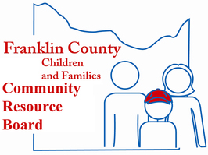
www.pfh.org 636-584-8724
www.fccrb.org

Slide 29
The Paper Towel Tower- Large sheets of paper, paper plates, tape, popsicle sticks
Mine Field- Leading a person or group of people through a course- could use paper or other objects.
Willow in the Wind- Circle of people, center person crosses arms and group moves them around the circle.
Group Juggle- Using three balls, move the balls around the group in an order randomly picked by the group- time them.
Knots- People or string

Slide 30
Back to back drawing- use random shapes and hove one person describe the shape while the other draws the shape.
Nuclear Waste- PVC pipe in two foot sections. Move a golf ball from one area to another, only using the pipes.
Duct tape- Group uses one finger to lower a roll of duct tape to the ground.
All Aboard- 2x2 platform, everyone must have at least one foot on the platform and the other off the ground.

